Slide 1

Introduction to Jenkins
A comprehensive overview of the leading open-source automation server powering modern DevOps workflows

Slide 2



What is Jenkins?
Jenkins is an open-source automation server that enables developers to build, test, and deploy their software reliably through continuous integration and continuous delivery (CI/CD) practices.
Automation Server
CI/CD Enabler
Extensible Platform
Jenkins automates the software development processes including building, testing, and deployment, reducing manual intervention.
Facilitates continuous integration by automatically testing code changes and continuous delivery by deploying validated code to production.
Features a robust plugin ecosystem with over 1,800 plugins that extend its functionality to integrate with virtually any tool in the development lifecycle.

Slide 3

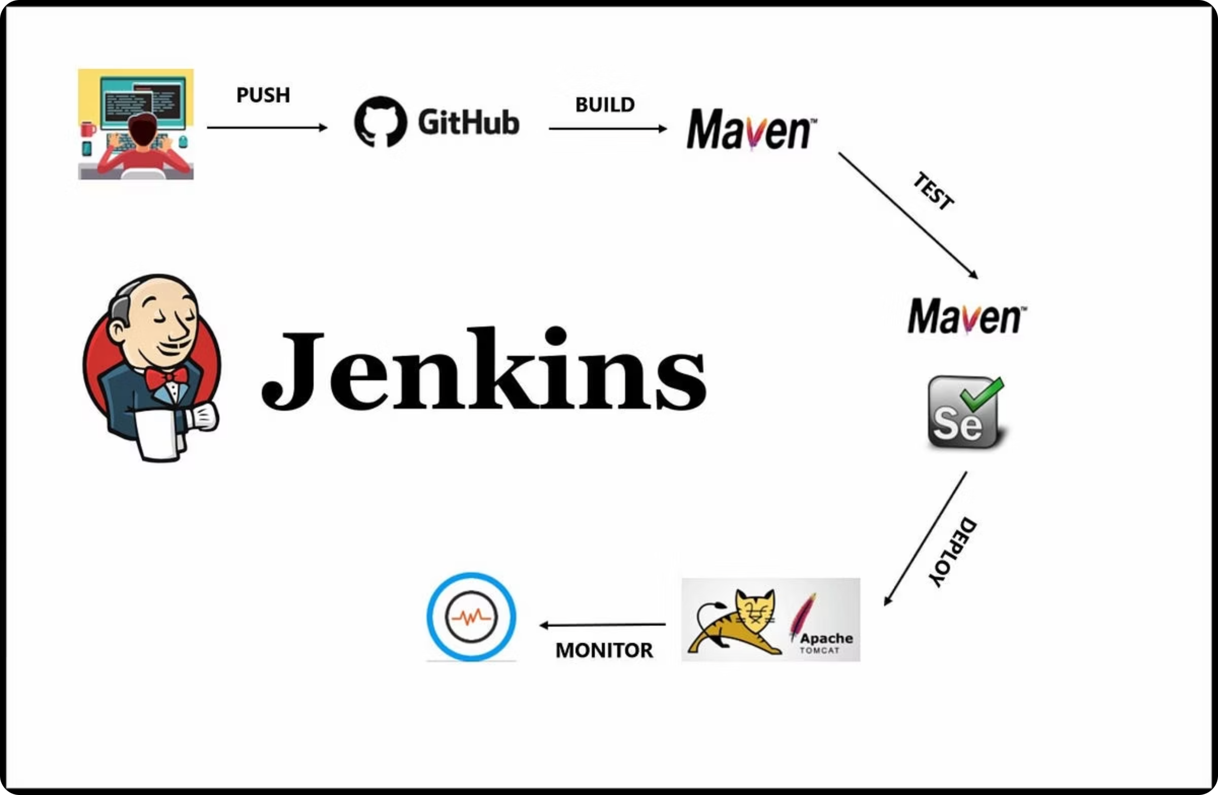
History and Evolution
1
2004
Hudson project started at Sun Microsystems
2
2011
Forked as Jenkins after Oracle acquisition
3
2016
Jenkins 2.0 released with Pipeline as code
4
2018+
Cloud-native features and Kubernetes integration

Slide 4
Why Jenkins is Popular
Jenkins has maintained its position as a leading CI/CD tool in the DevOps ecosystem for several compelling reasons:
Open Source & Free
Extensive Plugin Ecosystem
Zero licensing costs with enterprise-grade capabilities and community support
Over 1,800 plugins enabling integration with virtually any development tool
Flexibility & Customization
Strong Community
Adaptable to diverse workflows and technology stacks with Pipeline as Code
Active development, regular updates, and extensive documentation
These factors have made Jenkins the tool of choice for organizations ranging from small startups to large enterprises implementing DevOps practices.

Slide 5
Jenkins vs. Other CI/CD Tools
Tool
Strengths
Limitations
Jenkins
Highly customizable, extensive plugins, mature ecosystem
Requires maintenance, server management
GitHub Actions
Tight GitHub integration, cloud-hosted, YAML-based
Limited to GitHub, newer ecosystem
GitLab CI
Integrated with GitLab, container-native, YAML-based
Best with GitLab repositories
Azure DevOps
Microsoft ecosystem integration, comprehensive ALM
Less flexible, commercial pricing
While newer tools offer cloud-native approaches with less maintenance overhead, Jenkins remains popular for its unmatched flexibility and extensibility, especially in complex enterprise environments with diverse technology stacks.

Slide 6




Real-World Use Cases
Automated Testing
Continuous Deployment
Netflix uses Jenkins to run thousands of automated tests daily, ensuring high-quality streaming experiences across devices.
Amazon leverages Jenkins for continuous deployment pipelines that push code changes to production multiple times per day.
Security Scanning
Mobile App Builds
Financial institutions implement Jenkins pipelines with security scanning tools to identify vulnerabilities before deployment.
Mobile app developers use Jenkins to automate builds for iOS and Android platforms, managing complex signing and distribution processes.
These examples demonstrate Jenkins' versatility across industries and use cases, from startups to Fortune 500 companies.

Slide 7
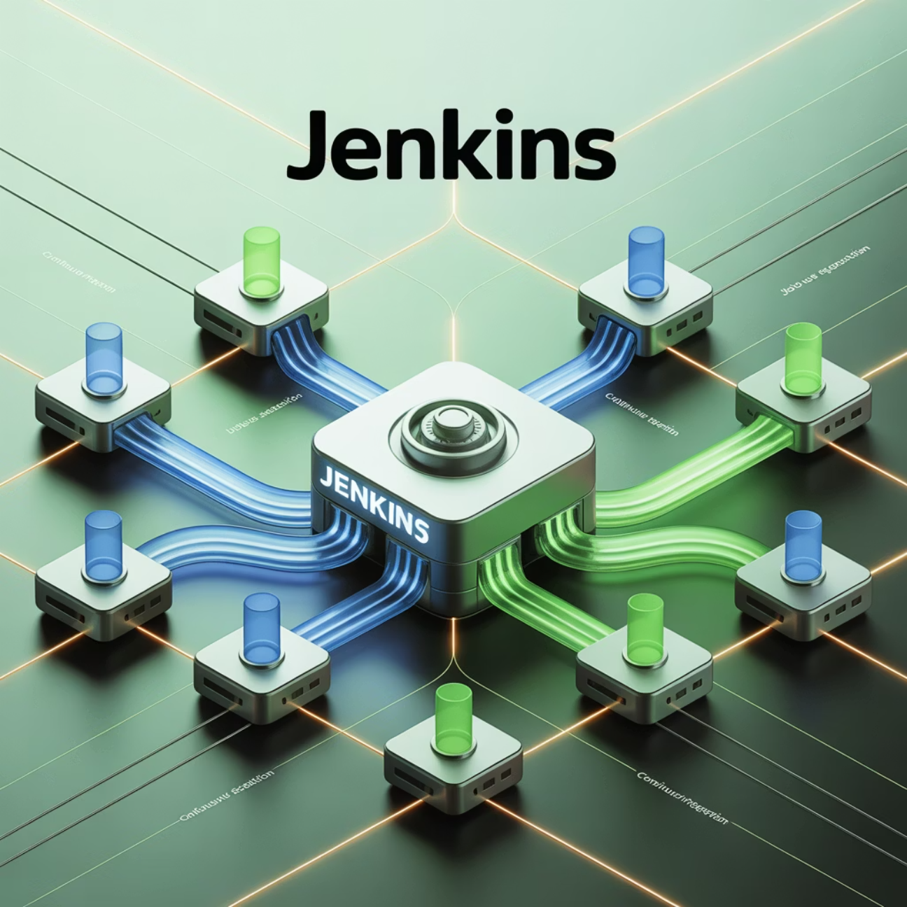
Key Jenkins Components
1
Jenkins Master
Central controller that schedules jobs, distributes work to agents, and provides the web UI for configuration and monitoring.
2
Jenkins Agents
Worker nodes that execute jobs in distributed environments, enabling parallel execution and heterogeneous build environments.
3
Pipelines
Code-defined workflows that specify the entire CI/CD process, enabling version control and treating infrastructure as code.
4
Plugins
Extensions that add functionality and integrations with other tools in the development ecosystem.

Slide 8
Getting Started with Jenkins
Create Your First Pipeline
Initial Configuration
Define your CI/CD workflow as code using the Jenkinsfile format, either through the UI or directly in your repository.
Installation
Set up security, install essential plugins, and configure your first pipeline using the intuitive web interface.
Install Jenkins on Linux, Windows, macOS, or deploy via Docker containers and Kubernetes.
docker run -p 8080:8080 -p 50000:50000 jenkins/jenkins:lts
Resources: Official Documentation | Plugin Index | Pipeline Examples
Thank you for your attention! Questions?

